Slide 1
WALT: To be able to recognise that vibrations from a sound travel through a medium to the ear.
KV: vibrations, soundwave, medium, ear

Slide 2
Recap Questions
How is sound made?
What is a wavelength?
What is amplitude?
What is energy?

Slide 3
Glossary – match the vocab to the definition
is the distance that a wave dips down or rises higher than its calm or flat surface,
Vibration
Wavelength
Amplitude
energy
quickly moving back and forth (or up and down) about a point
is the distance between two peaks of the wave
the ability to do work

Slide 4
Glossary – copy into books
Vibration -
Wavelength -
Amplitude -
Energy -
quickly moving back and forth (or up and down) about a point
is the distance between two peaks of the wave
is the distance that a wave dips down or rises higher than its calm or flat surface,
the ability to do work

Slide 5
Blindfold Game

Slide 6
How does sound travel?
Sound travels through the air, to your ear.
Air, water and tables are all mediums.

Slide 7
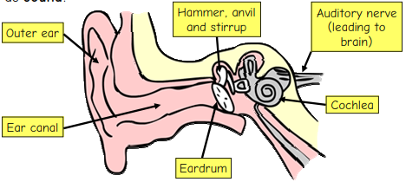
The Ear – label your picture.

Slide 8
Under your picture you are going to write a small paragraph to describe how we hear sound.
https://www.youtube.com/watch?v=HMXoHKwWmU8

Slide 9
WAGOLL
When a sound wave reaches our ear, our outer ear (the part that we can see on the side of our heads) funnels the sound into our heads and down the ear canal. At the end of the ear canal is the eardrum, which is waterproof and airtight. Past the ear canal is the middle ear. Inside the middle ear are the hammer, anvil and stirrup (the three smallest bones in the body) which vibrate and pass the sound waves to the inner ear, which contains the cochlea, which turns the vibrations into electrical signals. These signals travel down the auditory nerve to the brain, which experiences the signal as sound.

Slide 10
Quiz Time
Name one part of the ear
What is the definition of amplitude?
How do we hear sound?

