Slide 1
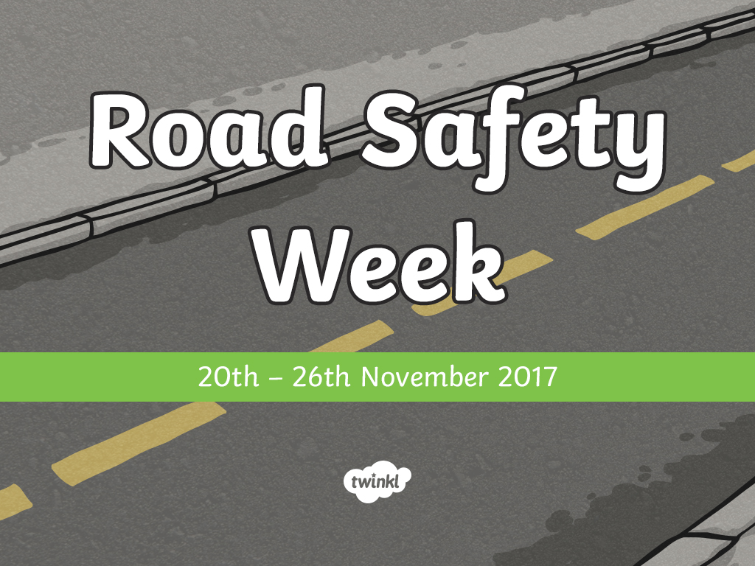

Slide 2
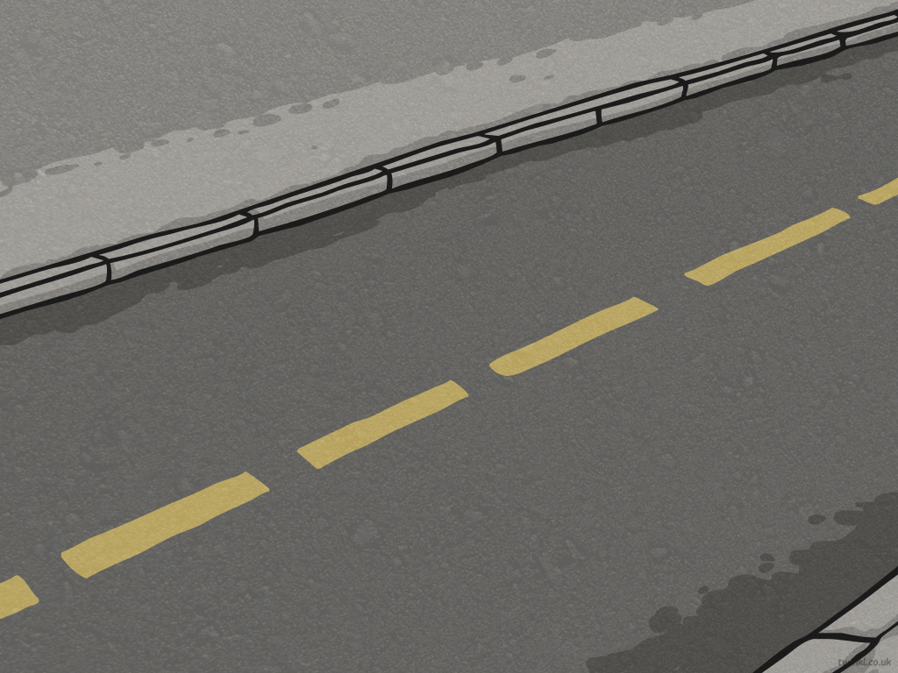
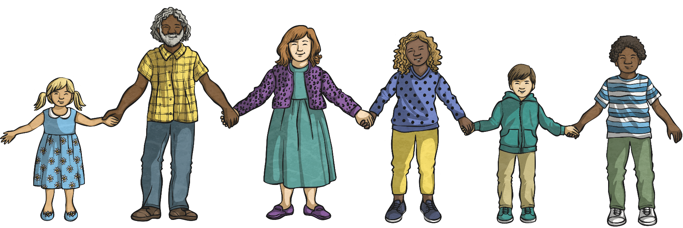
What Is It?
Road Safety Week is the UK’s biggest road safety event, organised by the charity ‘Brake’.
Schools, businesses and communities all around the country get involved to learn and spread the word about road safety.

Slide 3

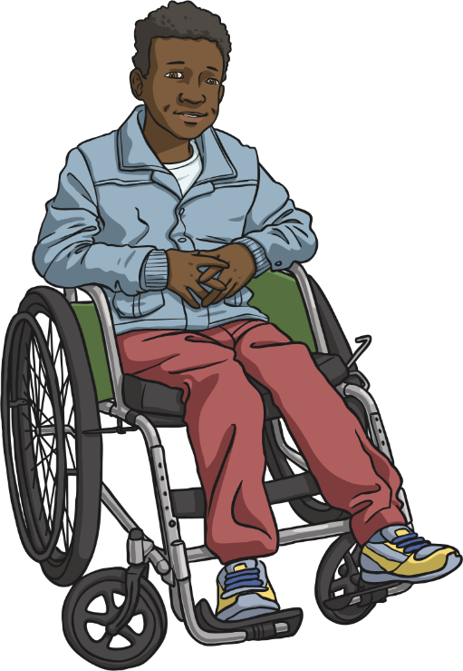
Why Do We Need It?
Brake started Road Safety Week in 1997 to raise awareness of road safety in order to cut the number of injuries and deaths on roads.
Deaths and injuries from road accidents have gone down since 1997
but more still needs to
be done to keep the
numbers going in the
right direction.

Slide 4
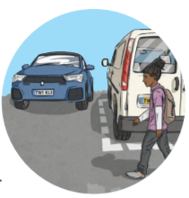
No Need to Speed
No Need to Speed is the theme for this year’s Road Safety Week.
Alarmingly, someone is injured on a UK road every four minutes and speed contributes to one in five fatal crashes.
In fact, speed is a critical factor in all road crashes and casualties. Driving can be unpredictable, so if something unexpected happens – such as someone stepping out into the road from between parked cars – the driver’s speed will determine whether they can stop in time. If they can’t stop in time, their speed will make a difference as to how hard the pedestrian is hit.
It could be the difference between life or death.

Slide 5
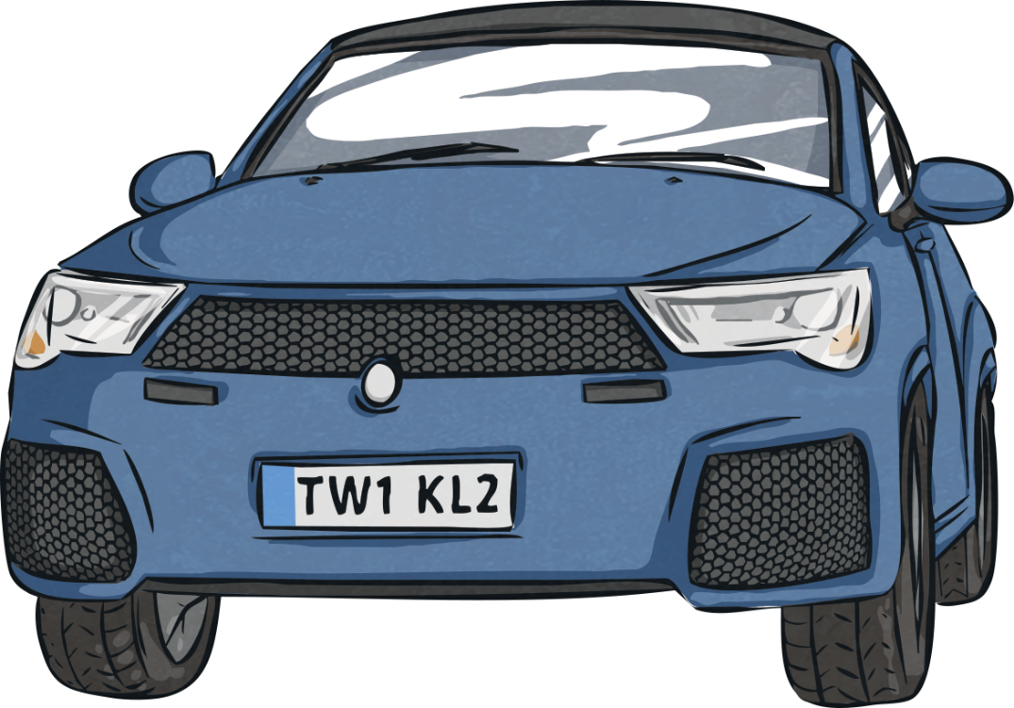
No Need to Speed
Unfortunately, people still regularly break speed limits or travel too fast for the conditions of the road, such as in frosty or wet weather.
Many accidents are easily avoidable or preventable.
Whether you are walking to school, riding a horse on a country road or driving to work - all road users should be aware of how to be safe on the roads, including how the speed
of the traffic makes a difference to our
welfare and safety.
That is why it’s time to come together to
say that there is No Need to Speed.

Slide 6




What Can We Do?
The ABCs
Awareness
Behaviour
Choice

Slide 7

Awareness
Traffic is Dangerous!
Over 186,000 casualties were reported in 2015 of which:
  over 16,000 were children;
  22,000 were seriously injured;
  over 1700 died.
In 2016, there were 18,477 cyclists and 19,297 motorcyclists
injured or killed on UK roads.
25% of people in hospital because of a road accident
are motorcyclists.
What do you think about these numbers?

Slide 8
Awareness
Being Distracted
What might distract you when you are walking or cycling? | What might distract someone or affect their driving?
texting phone ringing games on mobile phones taking photos talking singing skates or scooters something on the pavement | texting talking on the phone smoking eating drinking listening to music arguing speeding other people in the car doing something for a child road rage alcohol

Slide 9

Behaviour
How Do You Stay Safe?
Lollipop Lady
or Man
Pelican Crossing
(with traffic lights and a green man)
Footbridge
Traffic Lights
Barriers
Think of as many things as you can that we have to make crossing roads safer.
Traffic Island
Underpass
Zebra Crossing
(no traffic lights but black and white stripes on the road and Belisha beacons)
Toucan Crossing
(‘Two Can Cross’ for pedestrians and cyclists with traffic lights)
Equestrian Crossing
(for pedestrians and horse riders
with traffic lights)
Puffin Crossing
(Pedestrian User Friendly Intelligent)
Same as a pelican but with added sensors to detect speed of pedestrians

Slide 10

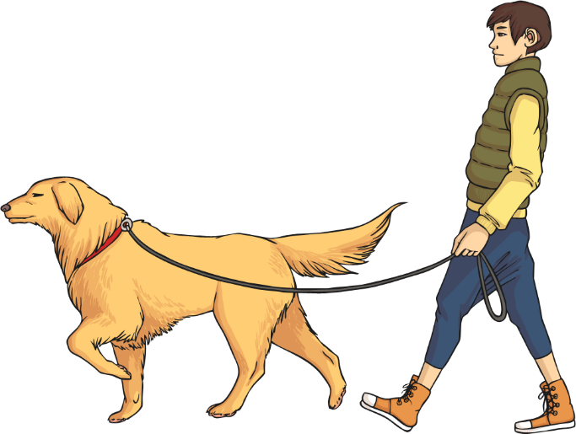
Behaviour
The Green Cross Code
Think – where is safe to cross?
Stop.
Look and Listen.
Wait until it is safe to cross.
Look and Listen as you cross.
Walk across the road, don’t run.

Slide 11
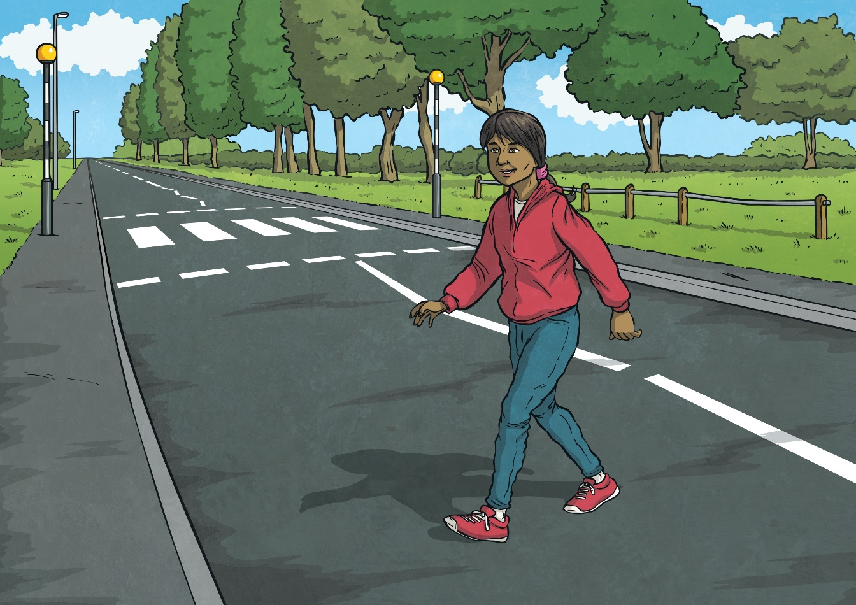
Behaviour
Other Behaviours That Can Keep Us Safe
Always try to use a pedestrian crossing when possible.
Try not to cross the road from between parked cars, or near trees and bushes, as drivers might not be able to see you.
Avoid crossing near a bend.

Slide 12
Behaviour
Questions
At which side should you get out of a car?
Reveal answer
Answer: The pavement side where possible.
After getting off a bus, when should you cross
the road?
Reveal answer
Answer: After the bus has moved away.

Slide 13

Choice
What to Wear
What to wear when walking | What to wear when cycling
What to wear when walking | What to wear when cycling
hi-vis jacket bright and reflective colours in the dark fluorescent (not reflective) colours show up in the daytime flat shoes laces done up reflectors on your bag | helmet reflective gear lights and reflectors on bikes no loose laces
What should you always
wear in a car?

Slide 14
How Much Do You Know?
What is the speed limit outside school?
Reveal answer
Answer: 30mph in built-up areas although some local councils can set speed limits outside schools to 20mph.
What should you always wear in a car and why?
Reveal answer
Answer: A seat belt because it stops you from being thrown forward in a crash.
Why should you reduce your speed in wet or frosty weather?
Reveal answer
Answer: It takes double the amount of time to stop in wet weather because your tyres will have less grip on the road. It takes up to ten times longer to stop in snow or ice. Reduce your speed and leave more space between you and the vehicle in front to account for greater stopping distances.

Slide 15

How Much Do You Know?
Which of these things shouldn’t you do when being a passenger in a car?
  Throw things in or out of the car.
  Lean out of the window.
  Block the driver’s view of the window or mirror.
  Argue or shout loudly.
Answer: All of these things!
Reveal answer

Slide 16


